Slide 1
Start a
Conference Call
www.qsgit.com
Notes:
----- Meeting Notes (2/21/17 09:23) -----
ok

Slide 2
Quantum Services Group
The Cloud Made Simple
Colocation
IT Support
Disaster Recovery
Phone Services
Internet Services
Web Design & Development
Web Hosting
VPN

Slide 3
The Cloud Made Simple
IT SUPPORT
HARDWARE
NETWORK
24/7/365 proactive support.
Install, repair, and configure.
Network design, management, and security.
WEB DESIGN
PHONE SYSTEMS
INTERNET
Boost your business with a website that works for you.
On-premise and hosted phone systems.
Custom internet and private cloud solutions.

Slide 4
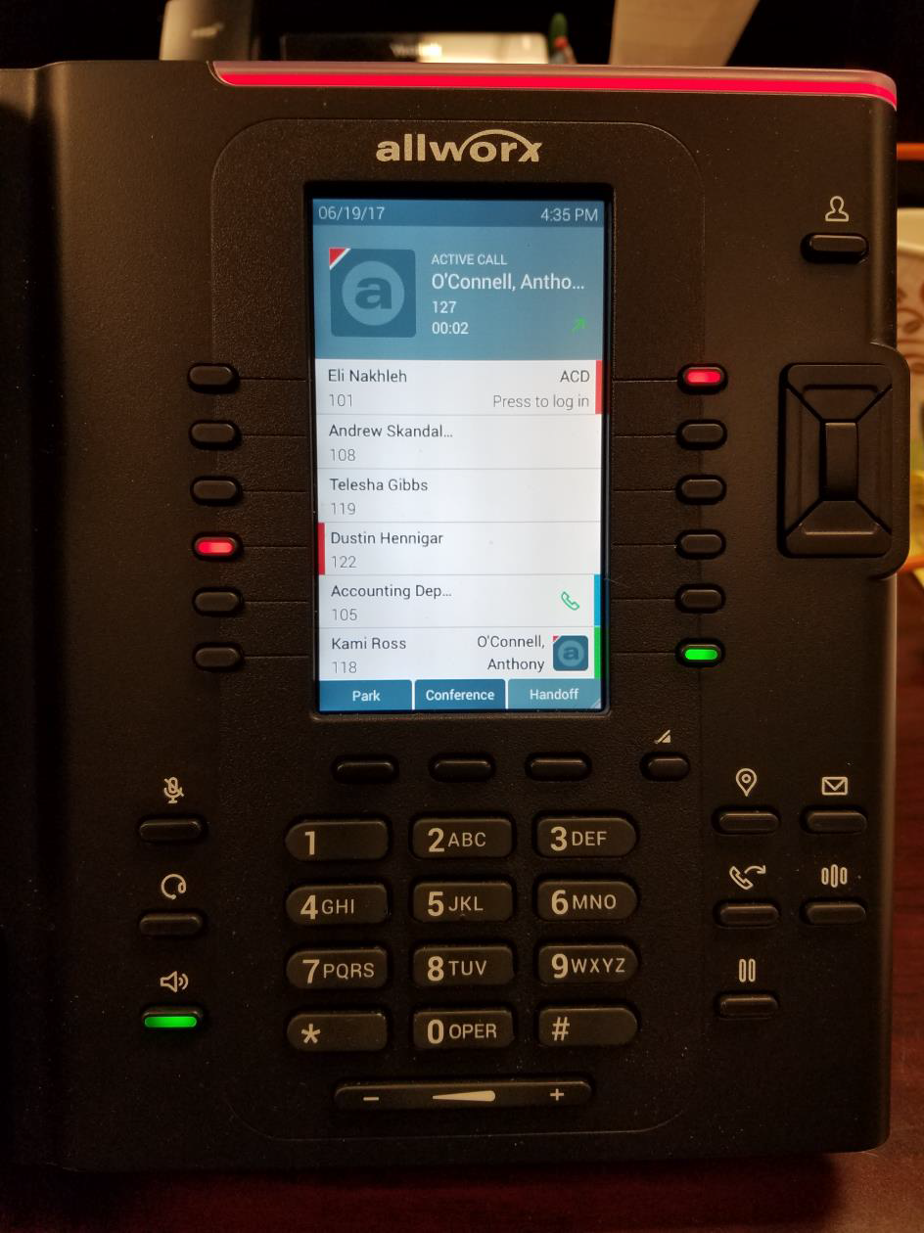
Step 1
During a call press the ‘Transfer Button’.

Slide 5
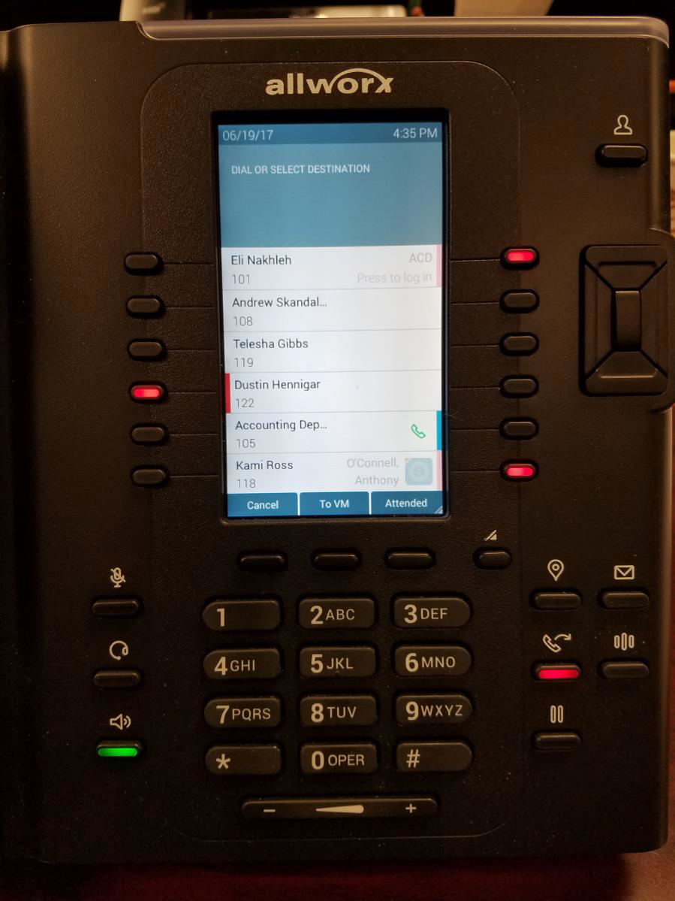
Step 2
Press the ‘Attended’ soft button.

Slide 6
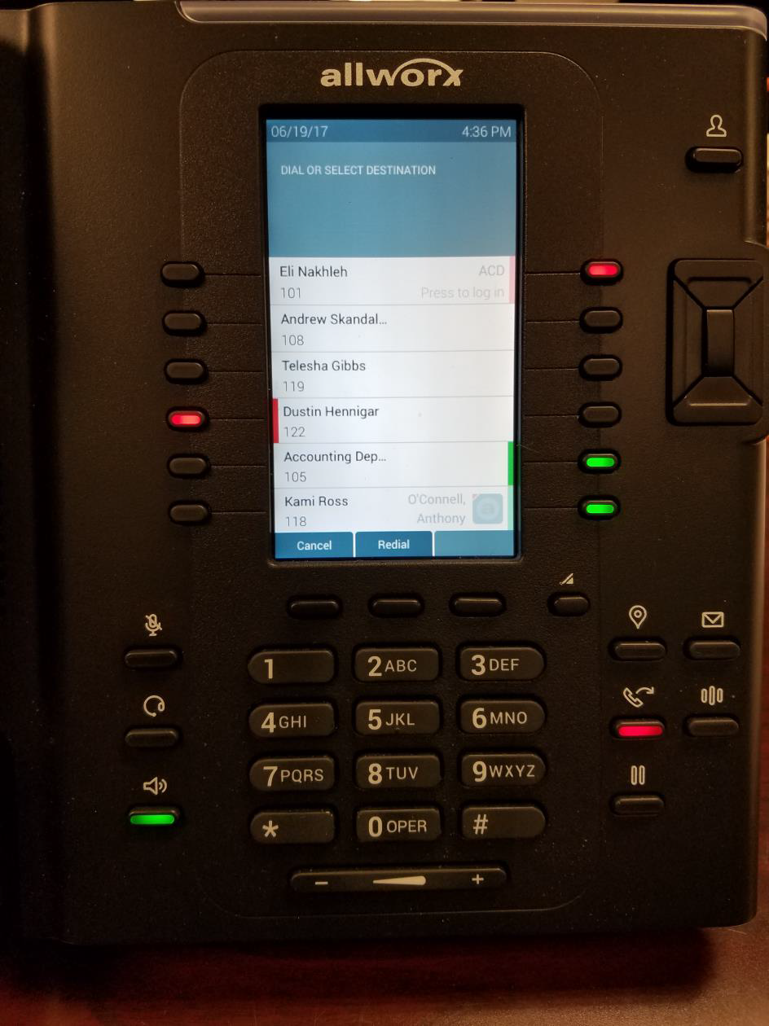
Step 3
Dial the extension you want to conference into the call.
Note:
*You can scroll through the phone directory to select a contact if you don’t know the user’s extension.
*You can also dial out to an external number.

Slide 7
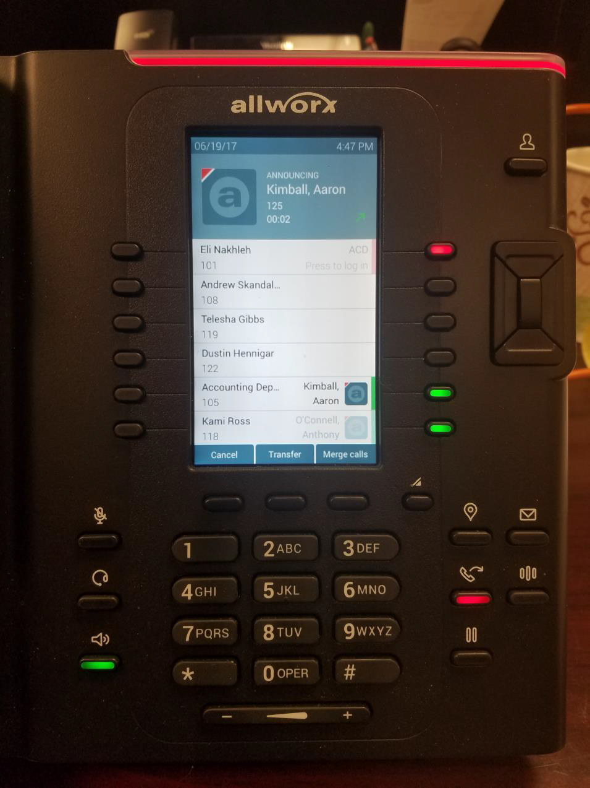
Step 4
After the third caller answers the phone, press the ‘Merge Calls’ button and select the second call to merge the calls.
2
1

Slide 8
STILL NEED HELP?
support@qsgit.com 248.247.3000 www.qsgit.com

