Slide 1
Transfer A Call
www.qsgit.com
Notes:
----- Meeting Notes (2/21/17 09:23) -----
ok

Slide 2
Quantum Services Group
The Cloud Made Simple
Colocation
IT Support
Disaster Recovery
Phone Services
Internet Services
Web Design & Development
Web Hosting
VPN

Slide 3
The Cloud Made Simple
IT SUPPORT
HARDWARE
NETWORK
24/7/365 proactive support.
Install, repair, and configure.
Network design, management, and security.
WEB DESIGN
PHONE SYSTEMS
INTERNET
Boost your business with a website that works for you.
On-premise and hosted phone systems.
Custom internet and private cloud solutions.

Slide 4
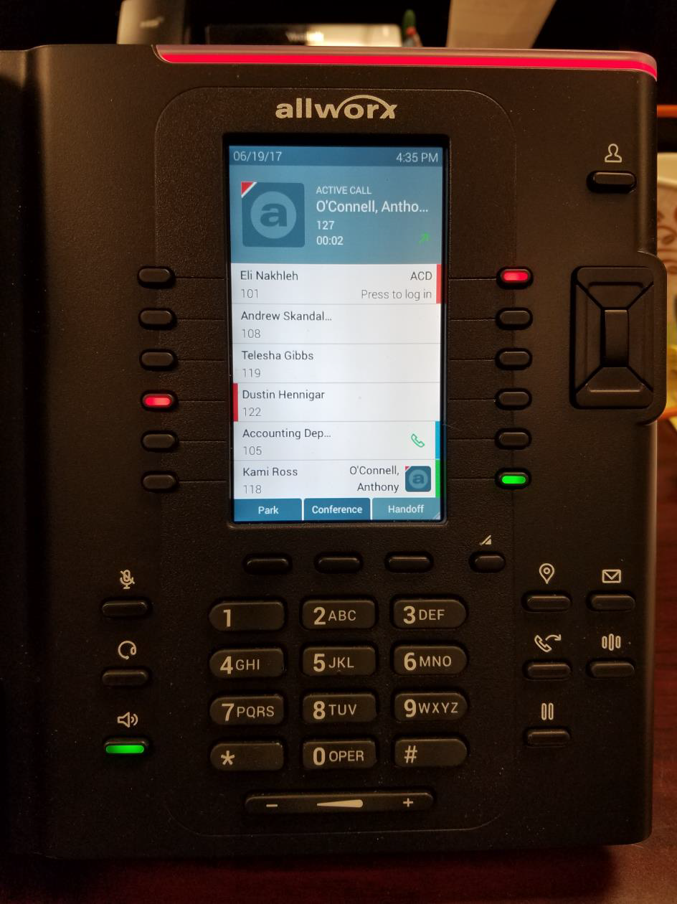
Soft Transfer
Step 1
During a call press the ‘Transfer’ button.

Slide 5
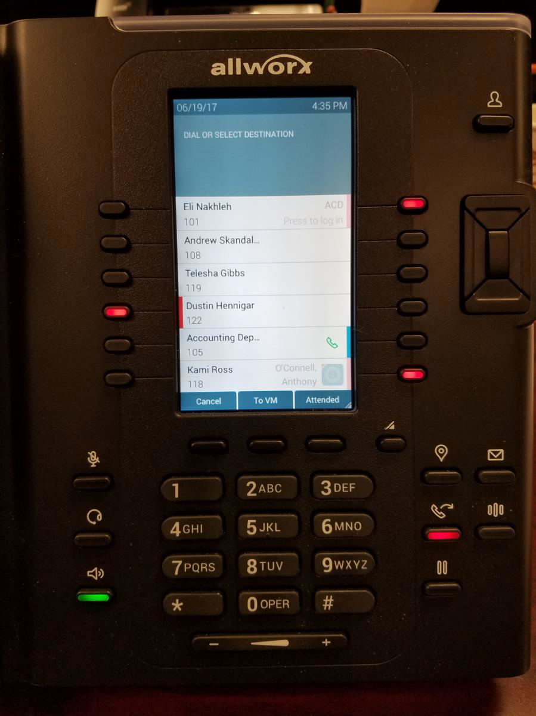
Step 2
Press the ‘Attendend’ soft button.

Slide 6
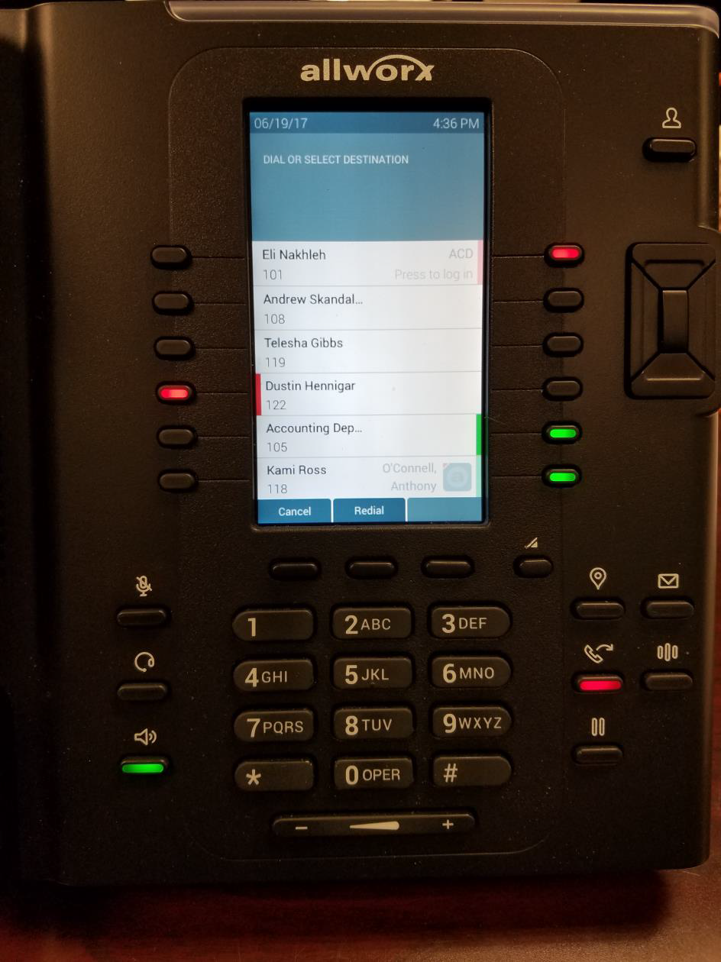
Step 3
Dial the extension you wish to transfer the call to.
Note:
*You can scroll through the phone directory to select a contact if you don’t know the user’s extension.
*You can also dial out to an external number.

Slide 7
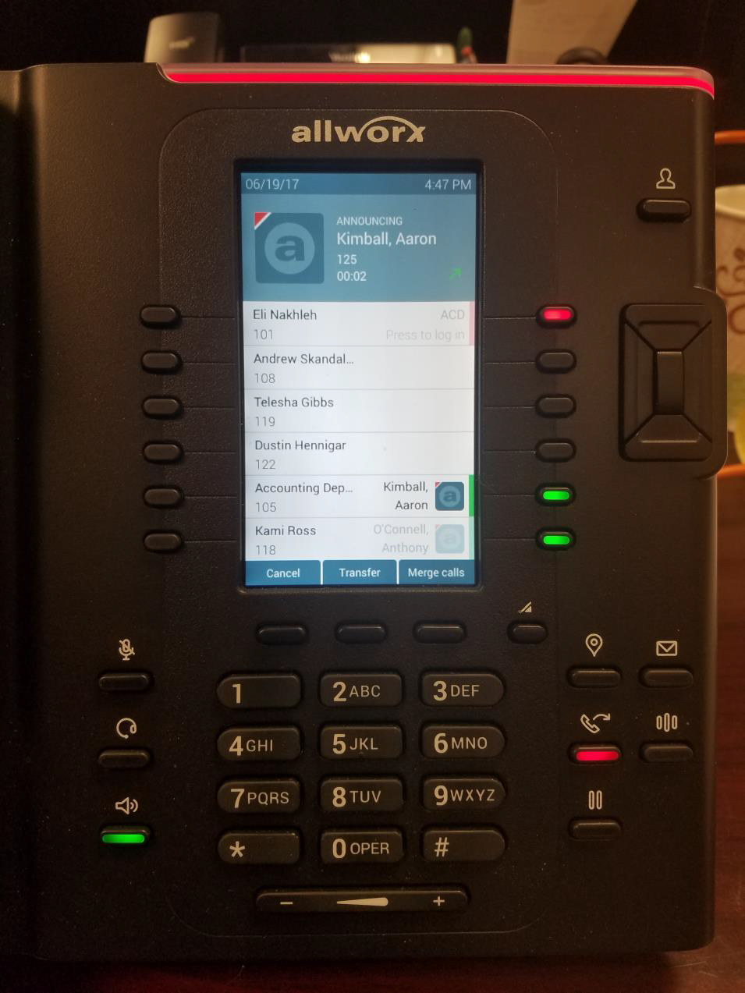
Step 4
After introducing the caller, press the ‘Transfer’ button to transfer the call.

Slide 8
Hard Transfer
Step 1
During a call, press the ‘Transfer’ button.

Slide 9
Step 2
Dial the extension you want to transfer the call to.
Note:
*You can scroll through the phone directory to select a contact if you don’t know the user’s extension.
After entering the extension the number is immediately transferred.

Slide 10
STILL NEED HELP?
support@qsgit.com 248.247.3000 www.qsgit.com

